Slide 1


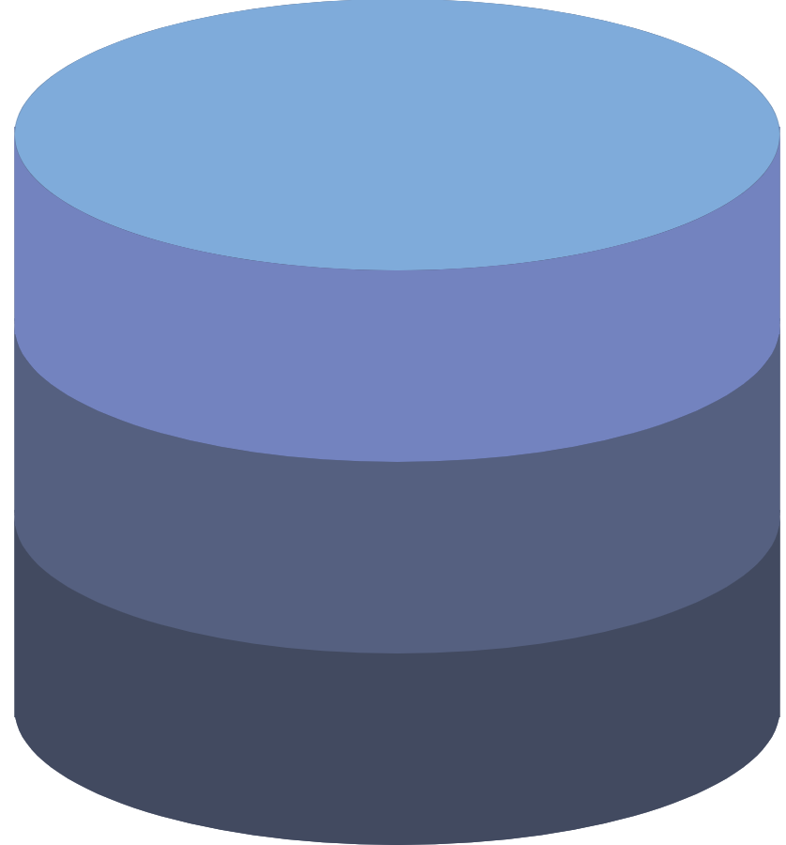

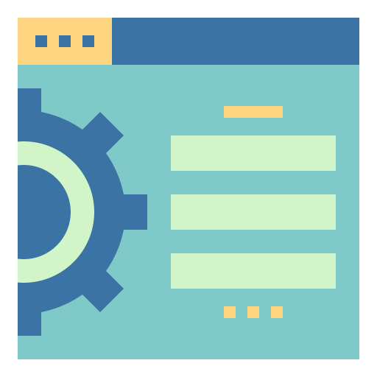
<소프트웨어 아키텍처>
Architecture
MiniERP
Chatting Program
Azure DataBase
Server
Machine Client
Machine Monitor

